Slide 1
Interfaces

Slide 2
Agenda
Interfaces
Implementing interfaces
Extending interfaces
Nested interfaces
The instanceOf operator

Slide 3
Interface
In Java, an interface is a reference type, similar to a class
Can contain constants & method signatures
There are no method bodies, all of the methods in an interface are abstract implicitly.
They lack instance variables, The only fields that can appear in an interface must be declared both static and final.
Cannot be instantiated — they can only be implemented by classes or extended by other interfaces
Variables & methods declared in interfaces are public implicitly.
An interface can extend another interface
A class can implement multiple interfaces
An interface is not a class. Writing an interface is similar to writing a class, but they are two different concepts. A class describes the attributes and behaviors of an object. An interface contains behaviors that a class implements.

Slide 4
Interface
Why interface?
To reveal an object's programming interface (functionality of the object) without revealing its implementation
This is the concept of encapsulation
The implementation can change without affecting the caller of the interface
The caller does not need the implementation at the compile time
It needs only the interface at the compile time
During runtime, actual object instance is associated with the interface type
To have unrelated classes implement similar methods (behaviors)
Class Line and class MyInteger
They are not related through inheritance
You want both to implement comparison methods
checkIsGreater(Object x, Object y)
checkIsLess(Object x, Object y)
checkIsEqual(Object x, Object y)
Define Comparison interface which has the three abstract methods above
To model multiple inheritance
A class can implement multiple interfaces while it can extend only one class

Slide 5
Defining interface
The methods which are declared have no bodies (abstract). They end with a semicolon after the parameter list.
Each class that includes an interface must implement all of the methods.
Variables can be declared inside of interface declarations. They are implicitly final and static, meaning they cannot be changed by the implementing class.
Variables must also be initialized with a constant value. All methods and variables are implicitly public.

Slide 6
Interface
Example of an interface declaration:
public interface Interface1
{
public void set(int i);
public int get();
}
Interface1 i1 = new Interface1();
Interfaces and Abstract classes can not be instantiated
6

Slide 7
Implementing Interface
To implement an interface, include the implements clause in a class definition, and then create the methods defined by the interface
If a class implements more than one interface, the interfaces are separated with a comma
If a class implements two interfaces that declare the same method, then the same method will be used by clients of either interface. Methods implementing interface has to be declared as public
The type signature of the implementing method must match exactly the type signature specified in the interface definition

Slide 8
Implementing Interface
It is both permissible and common for classes that implement interfaces to define additional members of their own

Slide 9
Accessing implementation through interface references
It is possible to declare variables as object references that use an interface rather than a class type.
Any instance of any class that implements the declared interface can be stored in such a variable. When you call a method through one of these references, the correct version will be called based on the actual instance of the interface being referred to. This is one of the key features of interfaces.
c.callback(42) will call implementation in Client class

Slide 10

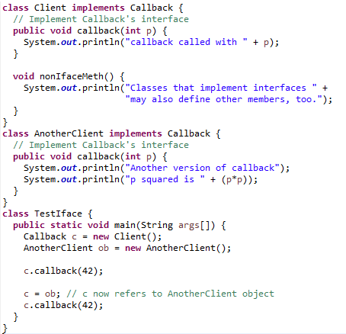
Accessing implementation through interface reference

Slide 11
Accessing implementation through interface reference
The method to be executed is looked up dynamically at run time, allowing classes to be created later than the code which calls methods on them.
The calling code can dispatch through an interface without having to know anything about the "callee." This process is similar to using a superclass reference access a subclass object, as described in Dynamic Method Dispatch.

Slide 12
Partial Implementation
If a class includes an interface but does not fully implement the methods defined by that interface, then that class must be declared as abstract.
abstract class Incomplete implements Callback {
int a, b;
void show() {
System.out.println(a + " " + b);
}
// ...
}
Here, the class Incomplete does not implement callback() and must be declared as abstract.
Any class that inherits Incomplete must implement callback() or be declared abstract itself.

Slide 13
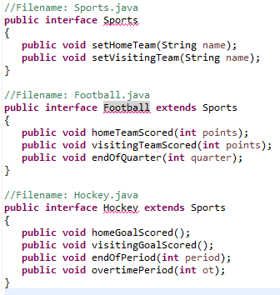
Extending Interface
An interface can extend another interface, similarly to the way that a class can extend another class.
The extends keyword is used to extend an interface, and the child interface inherits the methods of the parent interface.

Slide 14
Extending multiple interfaces
A Java class can only extend one parent class. Multiple inheritance is not allowed. Interfaces are not classes, however, and an interface can extend more than one parent interface.
The extends keyword is used once, and the parent interfaces are declared in a comma-separated list.
public interface Hockey extends Sports, Event

Slide 15
Nested Interfaces
An interface can be declared as a member of a class or another interface.
A nested interface can be declared as public, private, or protected. This differs from a top-level interface, which must either be declared as public or use the default access level
When a nested interface is used outside of its enclosing scope, it must be qualified by the name of the class or interface of which it is a member.

Slide 16
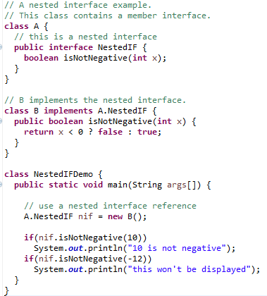
Nested Interface

Slide 17
The instanceOf operator
Used to check the actual type of an object
Has two operands:
A reference to an object on the left
A class name on the right
Returns true or false based on whether the object is an instance of the named class or any of that class's subclasses
Also known as type comparison operator

Slide 18
The instanceOf operator
A class definition
public class MotorBike implements Vehicle, Motorised
{
…
}
Vehicle bike = new MotorBike();
if (bike instanceOf MotorBike)
{
-------
}
Check whether the bike reference is an instance of MotorBike or not
11/12/2018
CONFIDENTIAL© Copyright 2008 Tech Mahindra Limited
18

Slide 19
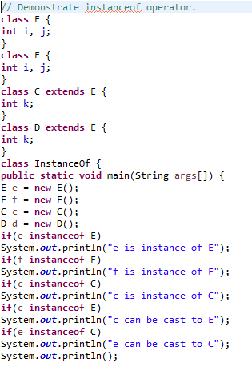
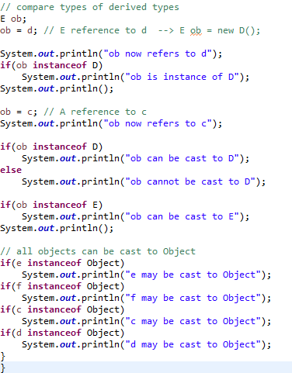
The instanceOf operator
11/12/2018
CONFIDENTIAL© Copyright 2008 Tech Mahindra Limited
19

Slide 20
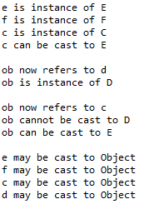
The instanceOf operator
Output
11/12/2018
CONFIDENTIAL© Copyright 2008 Tech Mahindra Limited
20

Slide 21
THANK YOU!!
ANY QUESTIONS??

